Slide 1
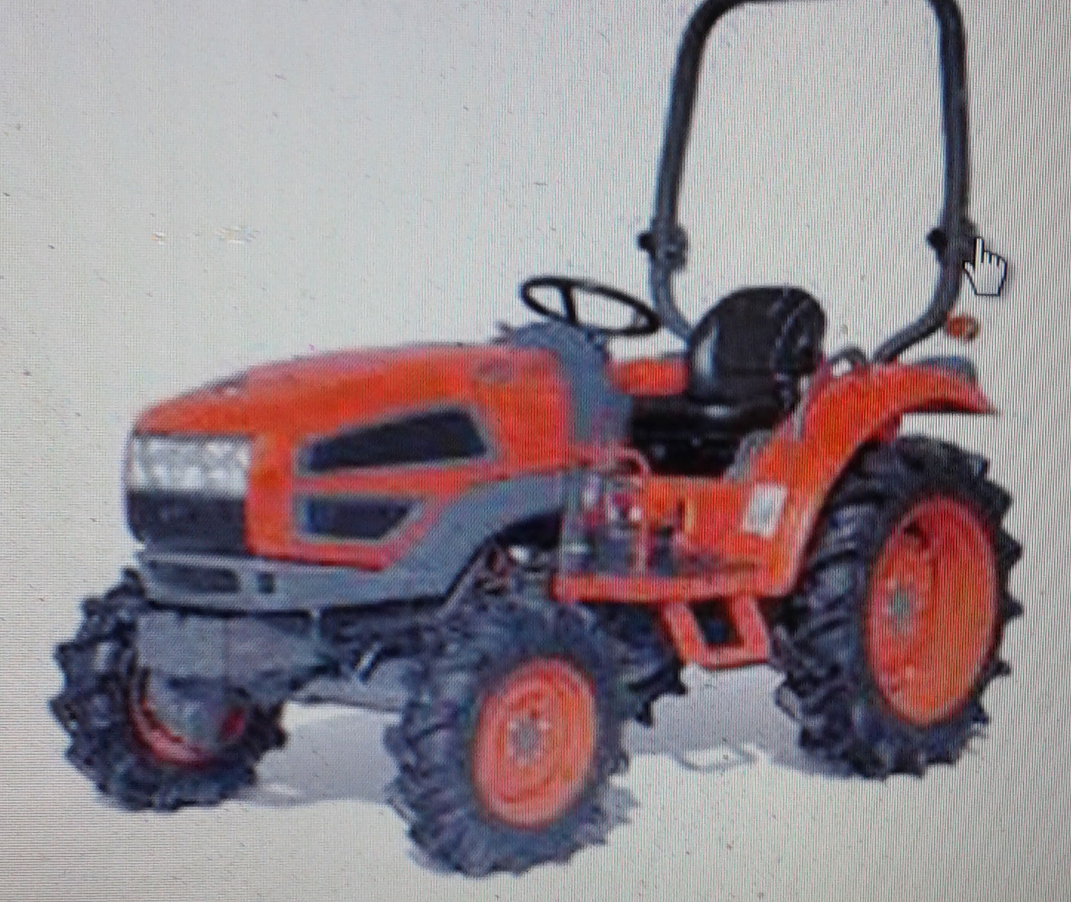
Types of Tractors
http://www.tractoragriculture.com/
TYPES OF TRACTORS

Slide 2
WHAT IS A TRACTOR?
The word TRACTOR was derived from 2 words:
i) Trac
ii) Tor
Trac was derived from word TRACTION
Tor was derived from the word MOTOR.
http://www.tractoragriculture.com/types-of-tractors/

Slide 3
Tractor Types
The Tractor Types can be classified into 3 parts like:
Types of Construction
Types of Drive
The purpose for which they are used

Slide 4
Tractor Types Continued
Construction Type Tractors are further sub divided into 2 parts:
i) Drive can easily sir and drive the tractor.
ii) This is called Walking Type of Tractor.
Type of Drive Tractors are divided into 2 parts:
i) Track Type
ii) Wheel Type

Slide 5
Tractor Types Continued
The third types of Tractors are listed below:
Utility Tractors
Row Crop Tractors
Orchard Type Tractor
Industrial Tractor
Garden Tractor
Rotary Tillers
Implement Carrier
Earth Moving Tractors

Slide 6
CONTACT INFORMATION
E-Mail : info@tractoragriculture.com

